Slide 1

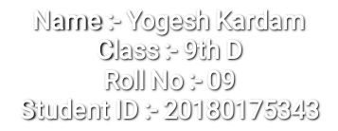
English Assessment

Slide 2

English
Assessment
Analyse - Different Perspective on Rain - Calamity to Joy
Examine - The Different Strategies and Perspectives
Analyse - how the narrator dealt with loss in 'A House is Not a Home

Slide 3
My Choice is :-
Analyse - Different Perspective on Rain - Calamity to Joy

Slide 4

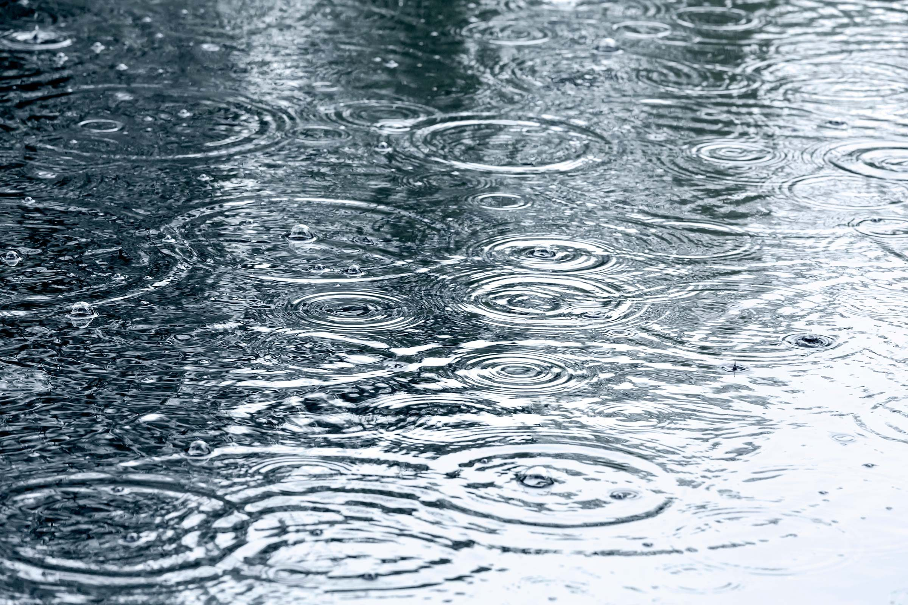
Rain
Different Perspective on Rain - Calamity to Joy
I will tell you about my perspective on rain. I don’t like rain because of our roads and streets are fully filled by dirty water and When I go out the vehicle splatter on me. but some things good in rain :-
rain come with cool air
we drink tea and eat pakoda, samosa and etc.

Slide 5

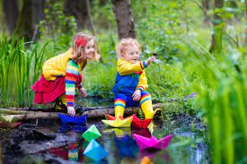
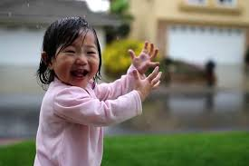
Childrens Perspective :-
Children like rain :-
The childrens are playing with paper boat in rain
Children are also like to bath in rain.

Slide 6
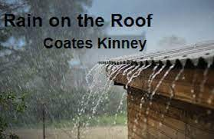
Rain on the roof
We know that when rainy water drops are fall down on the roof then water drops create a sound and the is good in listning and poet of ‘Rain on the roof ’ Coates Kinney like that sound.

Slide 7
Why people don’t like Rain?
They get wet (especially girls are pissed off when they get their hair wet)
It sometimes cancels their plans for the day
People who play ground sports can’t play because of mud
Sometimes flights are canceled due to weather
If people were not prepared by having umbrellas or jackets they might get sick

Slide 8
Why people like Rain?
People like watching the rainbow especially if they live somewhere where it doesn’t rain a lot
Rain is a sign of peace and refreshment also people like seeing rainbows (which don’t always appear)
It is a good time for family gatherings since families don’t sit together that much anymore
That smell of the earth when it rains is so delightful
A good time to do activities in home you haven’t done for a while like read, watch a movie, bake a cake, etc.

Slide 9

Thank You for
Watching

